Slide 1
From physical climate change to economic damages Estimating the costs and benefits of climate policy
Kaj-Ivar van der Wijst
Copernicus Institute for Sustainable Development

Slide 2




Integrated Assessment Models
Economy
Mitigation
Damages
Emissions

Slide 3
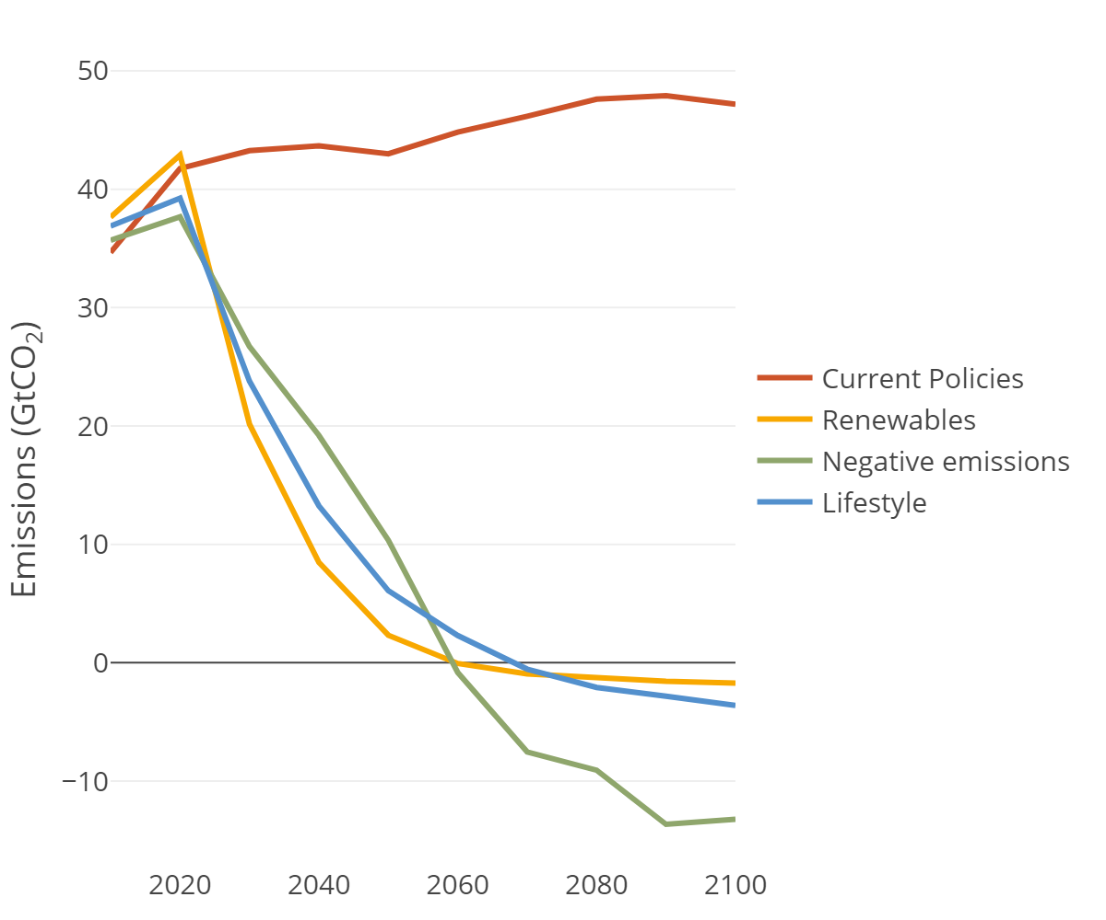





Mitigation
of emissions
Renewables:
Different ways to reduce emissions:
(Illustrative Mitigation Pathways from IPCC)
Current policies
Negative emissions:
CCS
Lifestyle:

Slide 4
Mitigation
of emissions
Hernieuwbaar:
Meerdere manieren om emissies te reduceren:
Costs to stay well below 2°C:
2050: 0.5-3% of GDP
2100: 1.7-7% of GDP
Negatieve emissies:
CCS
Gedragsverandering:

Slide 5
Integrated Assessment Models
Economy
Mitigation
Damages
Emissions

Slide 6
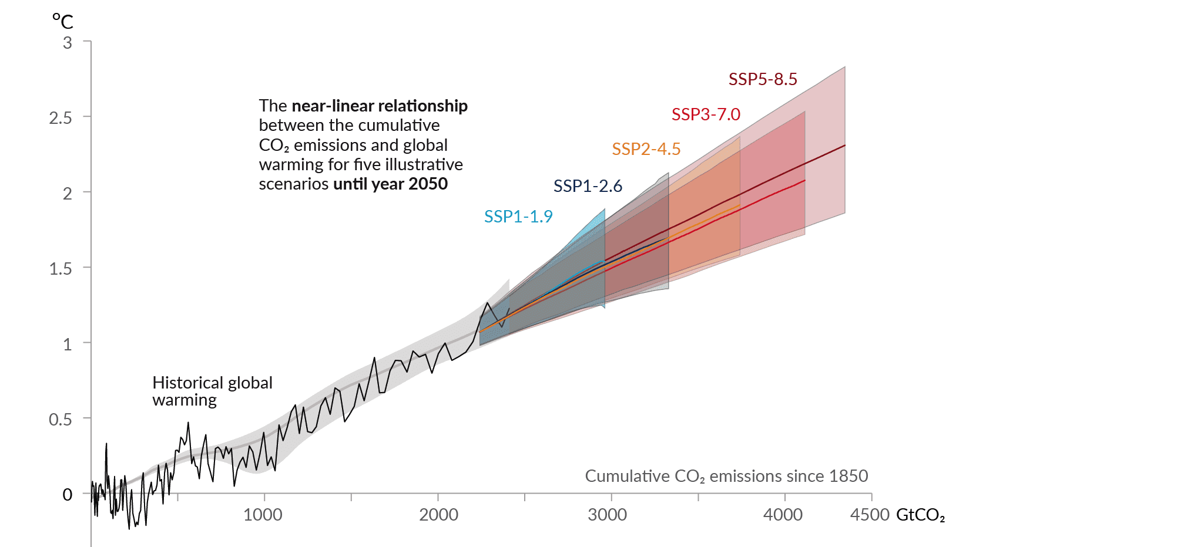
Emissions
to temperature
IPCC AR6 WGI
Fig. SPM10

Slide 7
Integrated Assessment Models
Economy
Mitigation
Damages
Emissions

Slide 8



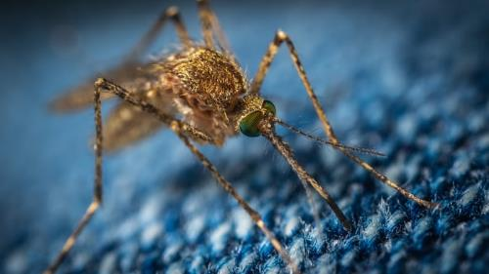
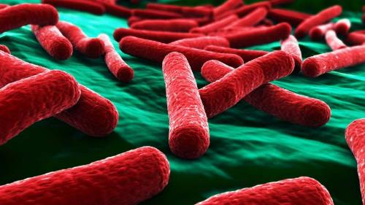
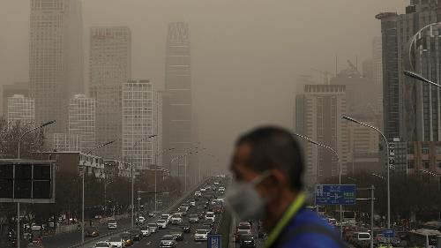





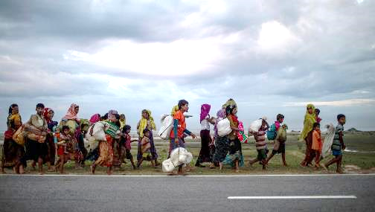
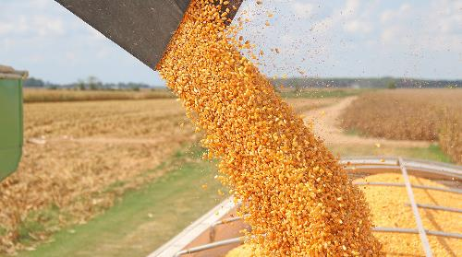



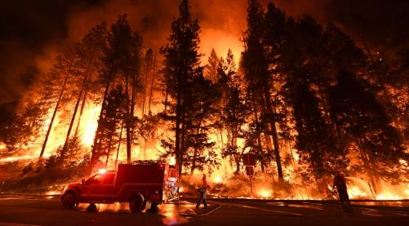

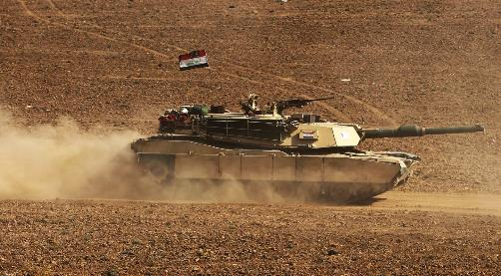
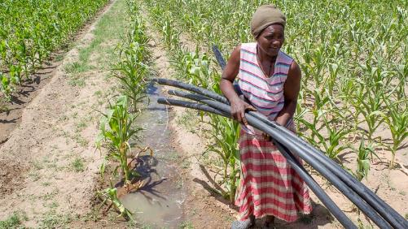



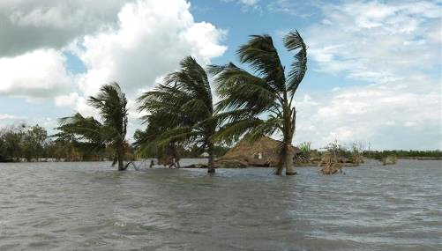

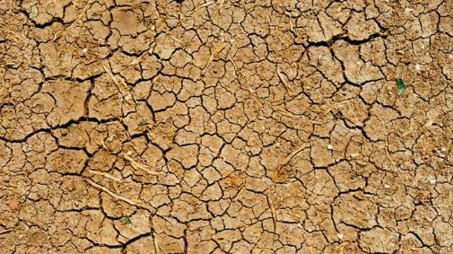




Damages
of climate change

Slide 9

Damages
of climate change

Slide 10


Damages
of climate change
Agriculture:
Climatic conditions → Yields
Models: EPIC, GLOBIOM

Slide 11
Damages
of climate change

Slide 12

Damages
of climate change
Energy production:
Sunshine, precipitation, droughts → impact on energy production
Models: CMIP hourly projections, LISFLOOD

Slide 13
Damages
of climate change

Slide 14

Damages
of climate change
Riverine floods:
Hydrological model → extreme events → physical damage to infrastructure
Models: GLOFRIS, LISFLOOD

Slide 15
Damages
of climate change

Slide 16

Damages
of climate change
Sea-level rise

Slide 17


Damages
of climate change
Sea-level rise
Simple equations for:
Thermal expansion
Annual damages
+
SLR
Glacier and Small Ice Caps
People at risk
Greenland Ice Sheet
Model: DIVA

Slide 18
Damages
of climate change

Slide 19



Damages
of climate change
Market damages
( )
CGE
Non-market damages

Slide 20
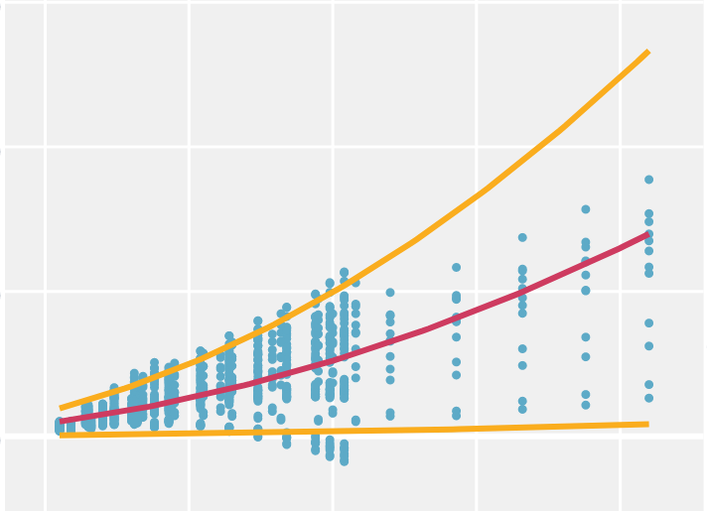








Damages
of climate change
High damages
15%
10%
GDP loss
Medium damages
5%
0%
Low damages
0.5°C
1°C
1.5°C
2°C
2.5°C
Temperature (relative to 1985-2005)
( )
Notes:
Regional damage functions for both SLR and non-SLR

Slide 21
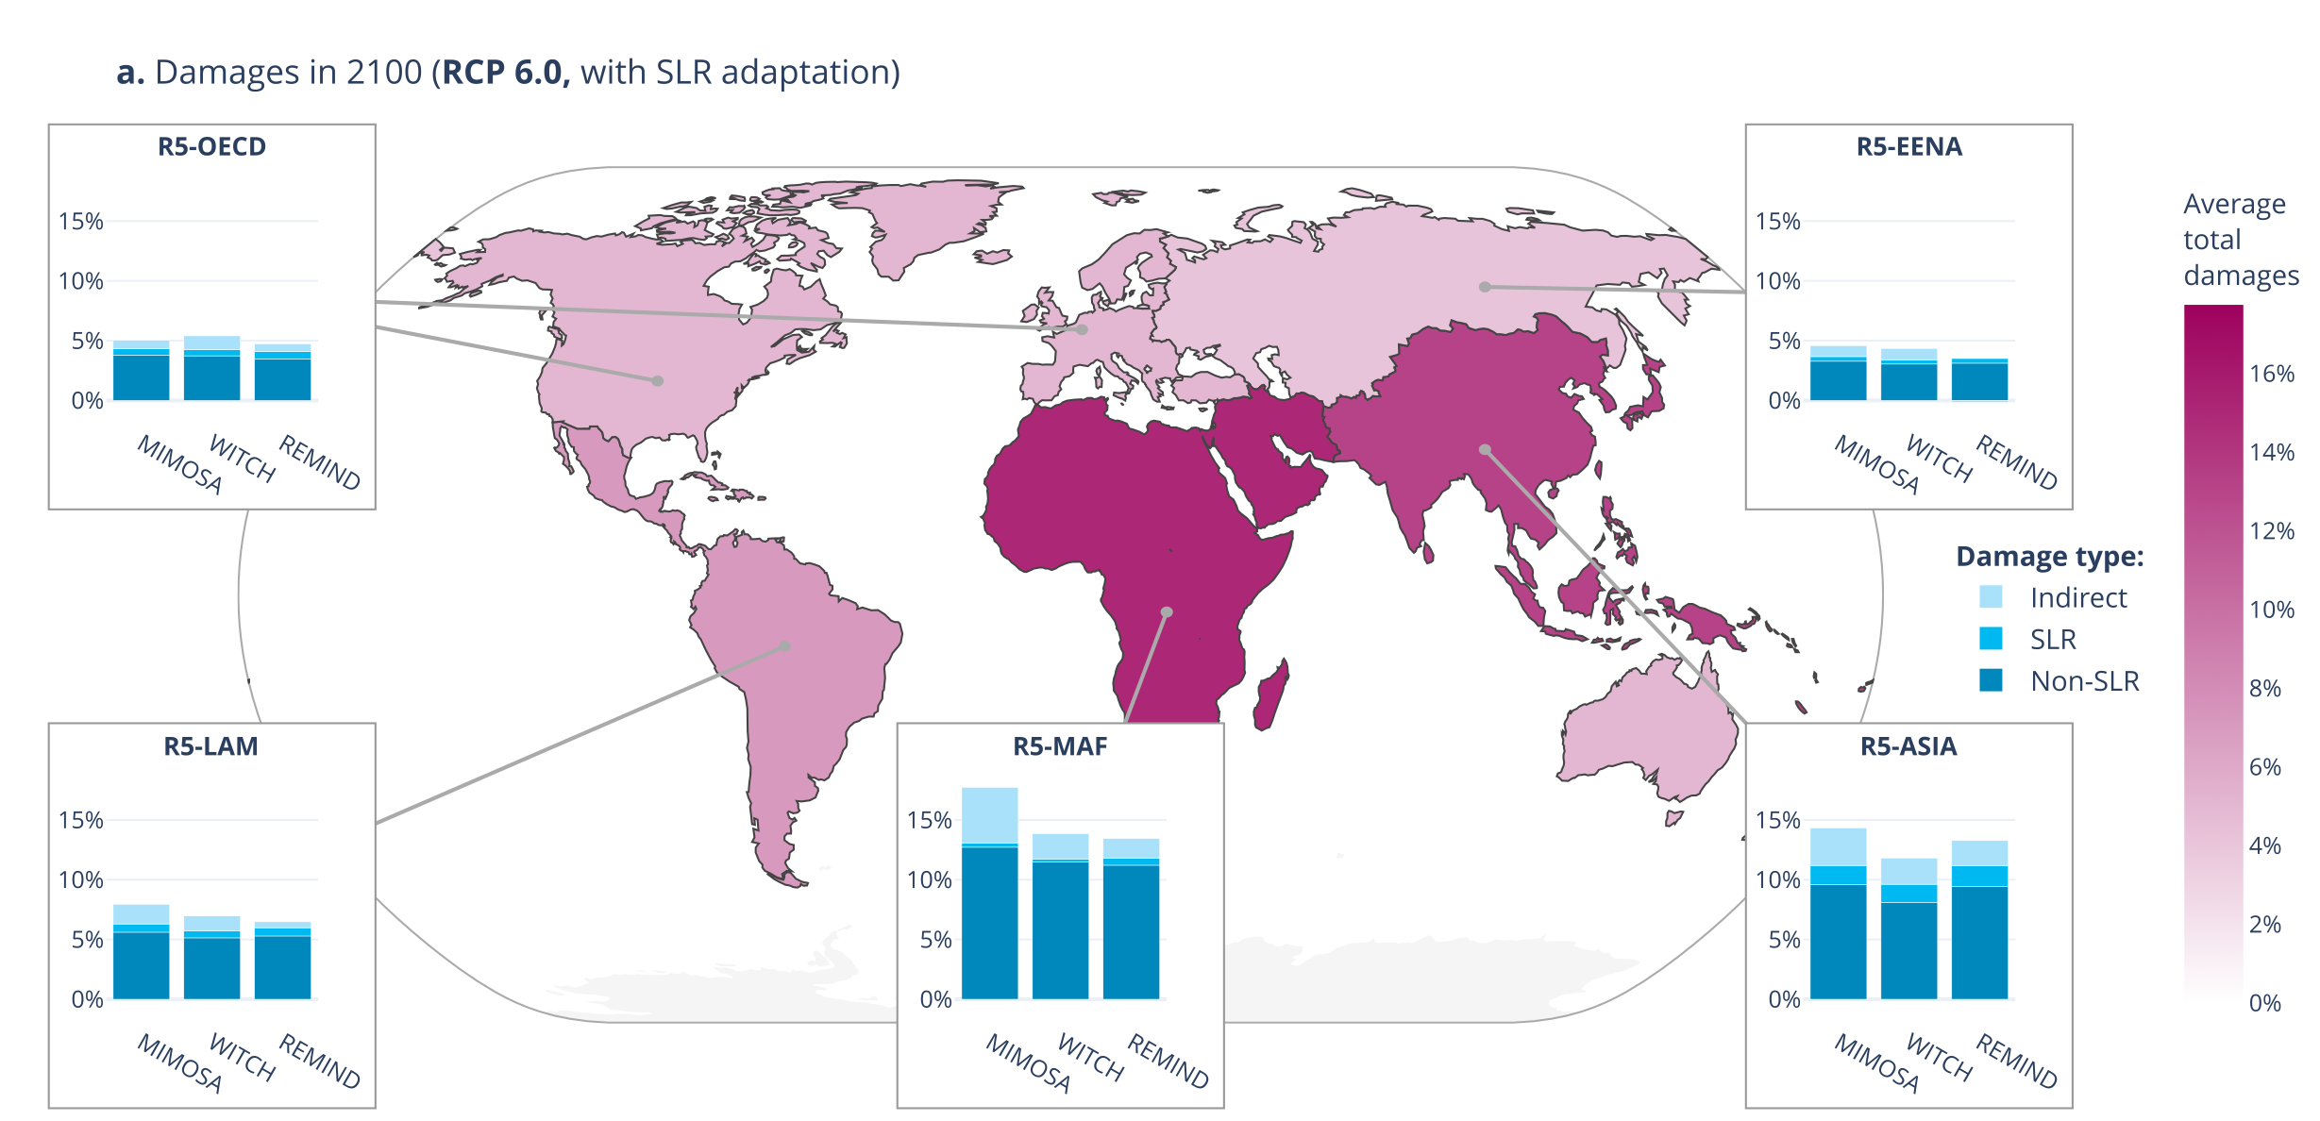
Damages
for little/no policy (3°C):
Large regional differences
Global damages around 10% GDP
Notes:
Actually for about 15 regions

Slide 22
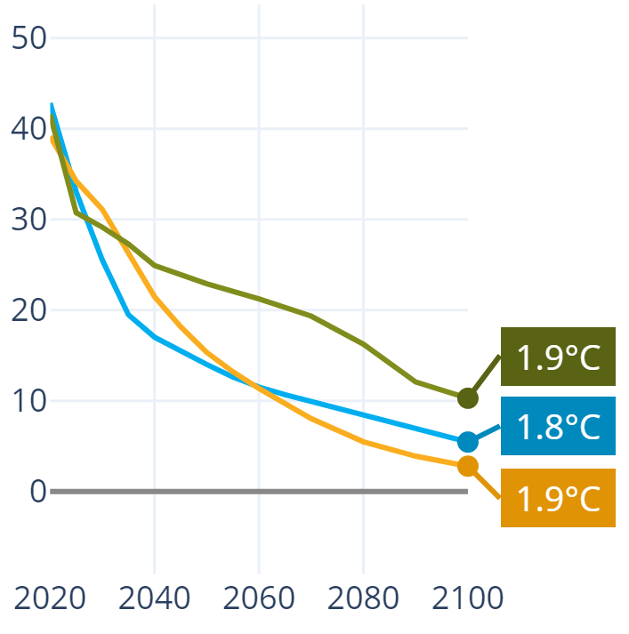
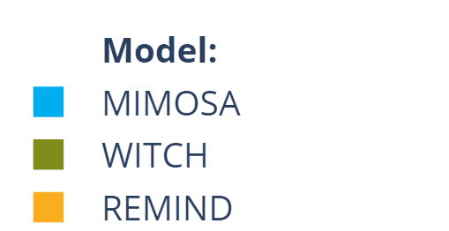
Cost-benefit analysis: optimal temperature
Paris economically optimal
even without health, biodiversity, tipping points…
CO₂ emissions (GtCO₂)

Slide 23
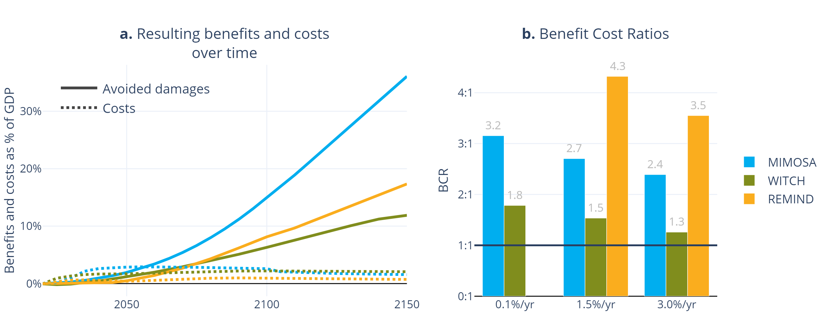
Cost-benefit analysis: Benefit Cost Ratio
a. Costs and benefits over time
b. Discounted costs/benefits (costs=1)

Slide 24
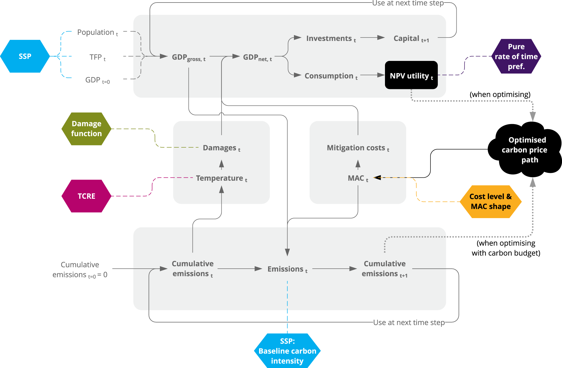

Integrated Assessment Model
pip install mimosa
https://kvanderwijst.github.io/MIMOSA/

Slide 25
Thanks, and I look forward to future collaborations!
Kaj-Ivar van der Wijst
Copernicus Institute
k.vanderwijst@uu.nl

Slide 26
